Slide 1
Introduction to Navigational Properties and Anonymous Data Sets
Navigational properties aid in linking data across tables.
Anonymous data sets: Flexibly structure data without a predefined type.

Slide 2
Navigational Properties
Basics: When we work with databases, especially relational databases, we deal with tables and the relationships between them. However, when programming, we often like to think in terms of objects. ORM tools, like Entity Framework, bridge this gap, allowing us to interact with our database using object-oriented constructs

Slide 3
Navigational Properties - Continue
Navigational Properties: Navigational properties are a feature in ORMs, specifically in Entity Framework, that provide a way to navigate from one entity to another. In simpler terms, they represent the relationships between tables in the form of properties on our classes (or entities).

Slide 4
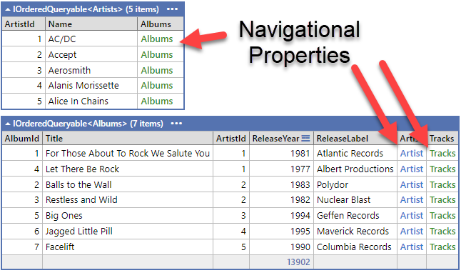
Navigational Properties - Continue
For instance, consider two tables in a database: Artists and Albums. An artist can record multiple albums, so there's a "one-to-many" relationship between Artists and Albums.

Slide 5
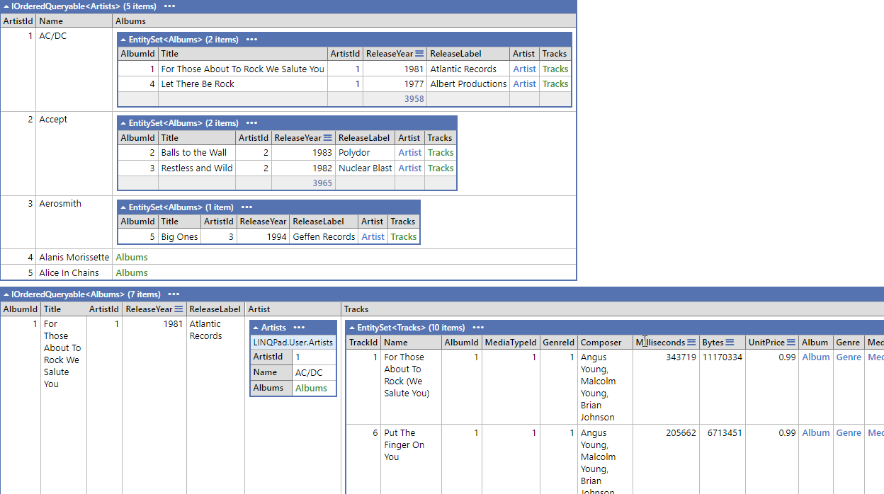
Navigational Properties - Continue
Artists .Where(x => x.ArtistId < 6).Dump();
Albums .Where(x => x.ArtistId < 6) .OrderBy(x => x.ArtistId) .Dump();

Slide 6
Benefits of Navigational Properties:
Intuitive Access: You can navigate relationships in code as if you were working with regular object properties. It abstracts away the underlying SQL joins and queries, making code more readable.
Eager vs Lazy Loading: Entity Framework supports both eager loading (loading related entities upfront using the Include method) and lazy loading (loading them on-demand when accessed).
Cascade Deletes: You can set up cascading deletes using navigational properties. If an Author is deleted, all their Books can be set to be deleted automatically.

Slide 7

Anonymous Data Sets
Definition: Collections of objects of an anonymous type.
No predefined class, defined on-the-fly.
Can be a subset of the current dataset.
Can be a collection of Fields, Concatenation of fields, Complex Calculations, Queries, etc.
Especially useful in LINQ for shaping data.
Uses “new” as a keyword for creating an Anonymous Dataset.

Slide 8
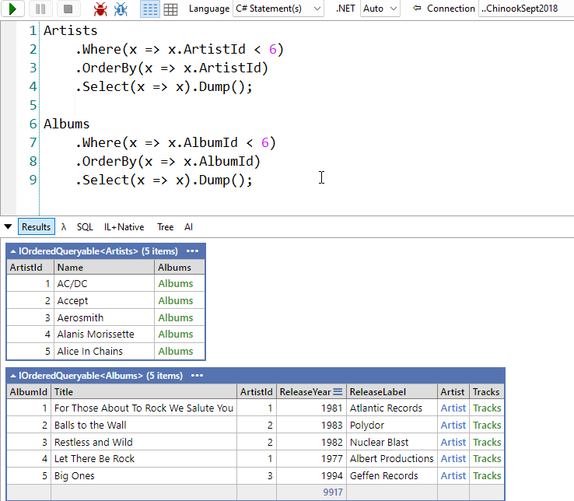
Understanding Anonymous Data Sets with Artists & Albums
Let's return the top 5 records for Artists and Albums

Slide 9
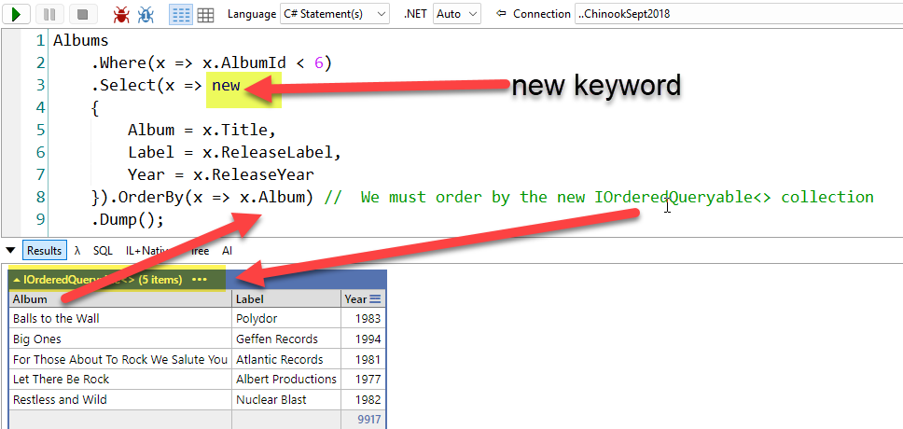
Understanding Anonymous Data Sets with Artists & Albums
From the Albums dataset, let’s return only the Title, Release Year, and Release Label. We will create user-friendly names by renaming the Name to Album, Release Year to “Year,” and “Release Label” to “Label.” We will also change the field’s order to => Album, Label, and Year. Lastly, we order by Album.

Slide 10
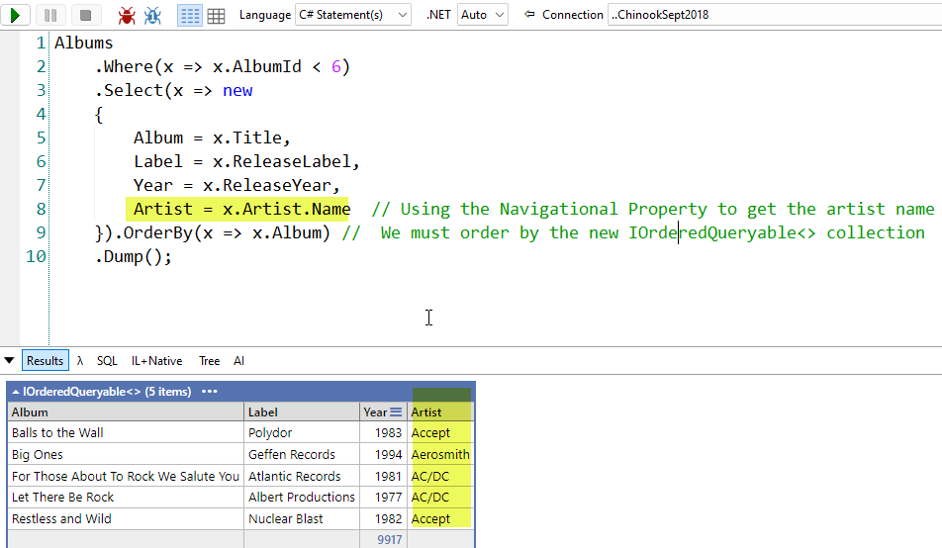
Understanding Anonymous Data Sets with Artists & Albums
Let’s now include the Artist name into the collections.

Slide 11
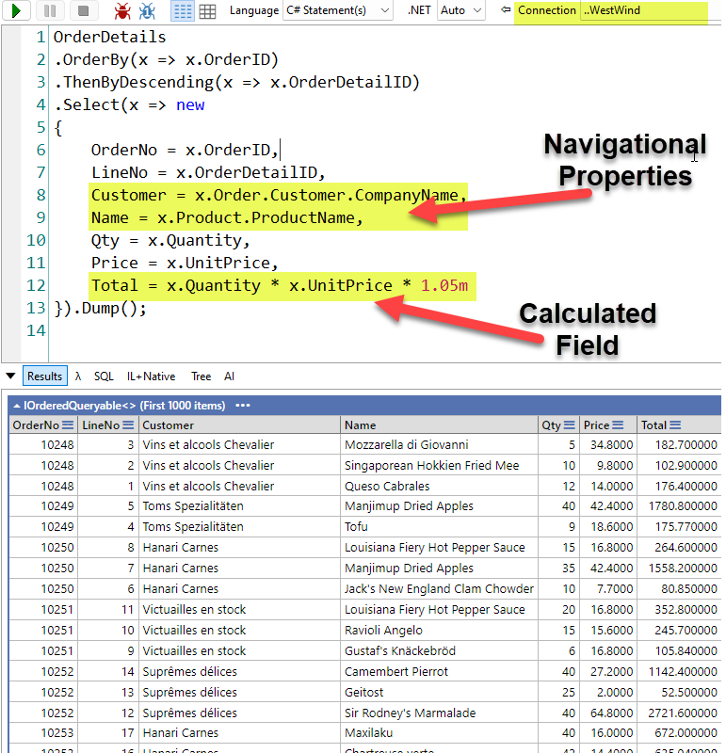
Understanding Anonymous Data Sets with Order Details (West Wind)
Let’s output the Order Details lines order by Order # and then OrderDetailID descending the following information
OrderId -> OrderNo
OrderDetailID -> LineNo
Companyname -> Customer,
ProductName -> Name
Quantity -> Qty
UnitPrice -> Price
Total -> Quantity * UnitPrice * 1.05

Slide 12

Statement Regarding Slide Accuracy and Potential Revisions
Please note that the content of these PowerPoint slides is accurate to the best of my knowledge at the time of presentation. However, as new research and developments emerge, or to enhance the learning experience, these slides may be subject to updates or revisions in the future. I encourage you to stay engaged with the course materials and any announcements for the most current information

